Slide 1
Symbology

Slide 2
Contents
Communication and graphic communication
Symbolization
Symbol types
Visual variables

Slide 3
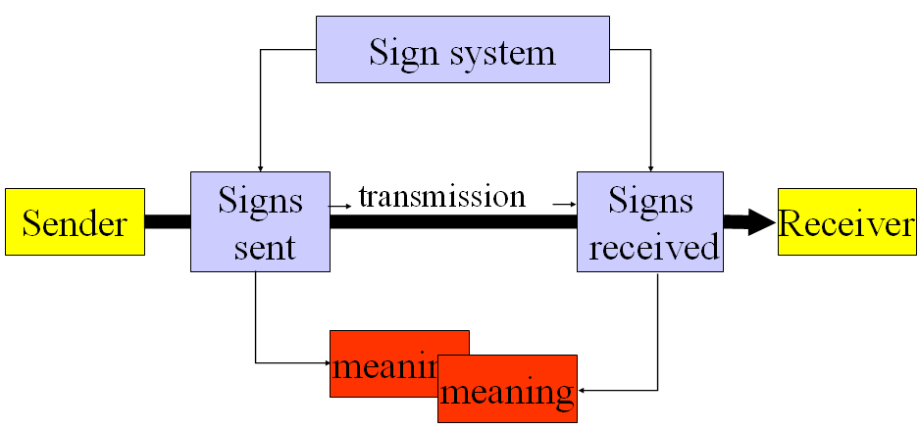
Communication

Slide 4
Graphic communication and map graphics
Graphic art designer can freely select design elements according to natural judgement.
Map graphics is restricted to the form of the natural phenomena, their position, shape, size, and often their colour (scientific art)
People can easily perceive map graphics by convention and symbol.
Map graphics are not as subjective as other graphic communication.

Slide 5
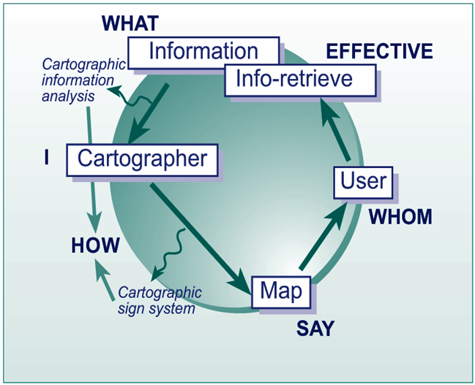
Cartographic communication process
How do I say what to whom and is it effective?

Slide 6
Symbolization
Process of assigning symbols to represent features.
legibility (‘practical’), harmonious (‘pretty’)
symbols can be iconic ( pictorial), geometric or abstract, textual
symbol selection is creative aspect of design, wide choice and few firm rules
symbols can have several different dimensions (properties or characteristics) which encode meaning, quantitative or qualitative

Slide 7
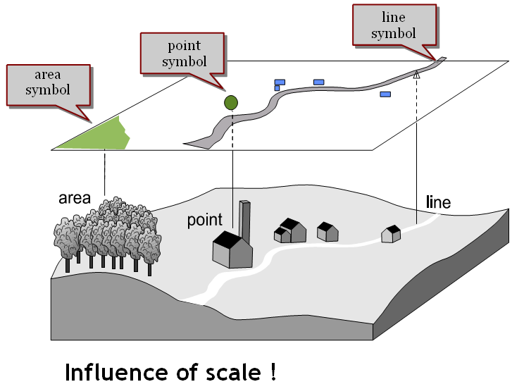

Slide 8
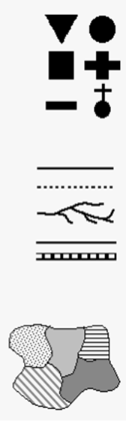
Symbol groups
Point symbols
Line symbols
Area symbols

Slide 9
Cartographic symbols
Point symbols
Represent location and characteristics of features of small territorial extent ( in addition to map scale)
3 types – depending upon their construction
Geometric / abstract
Pictorial / descriptive
Textual
Qualitative and quantitative
Qualitative – showing characteristic feature
Distribution of hospitals in Kathmandu.
Quantitative – describe certain quantity,
point, squares/rectangles, cubes / spheres.
No of KU students from different districts.

Slide 10
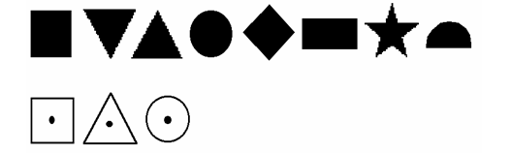
Geometric point symbol
Simple geometrical shapes such as circles, squares, rectangles, triangles etc.
advantage
Easy to construct
Cover relatively small area of map with high positional accuracy
Disadvantage
No direct visual relationship to the object represented.

Slide 11
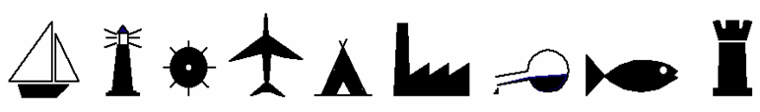
Pictorial point symbol
Advantage
easiest to interpret, giving as they do, a life-like image of the actual feature.
Disadvantage
Difficult to find exact location of the object being represented.
Difficult to construct
Occupy relatively more space
Difficult to adjust the optical / visual weight

Slide 12
Textual symbol
abbreviation or short forms of the feature category
P for phosphorous, Fe for iron
Advantage
Easy to construct
Easy to understand and remember
Disadvantage
Do not exactly show the location
Difficult to adjust the optical / visual weight
Mixing up with the map text
Graphics more efficient
Occupy much space

Slide 13
Line symbols
To represent the linear, in geometric sense, ground objects.
width of linear objects can not be represented in the map scale.
Administrative boundary, telephone and electricity lines, road, river, canal.

Slide 14
Area symbol
To represent the ground objects having considerable extent in all direction which can be shown at the map scale.
may be abstract or pictorial.
Pictorial in the sense that a number of pictorial point symbols appearing to close to each other to depict the nature of the area.

Slide 15
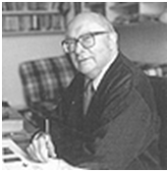
Visual variables:
Several characteristics of a symbol that can be manipulated.
Bertin’s graphic (visual) variables:
Position – for locational aspects of geospatial data
Form, orientation, colour, texture, value and size for the thematic attributes.

Slide 16
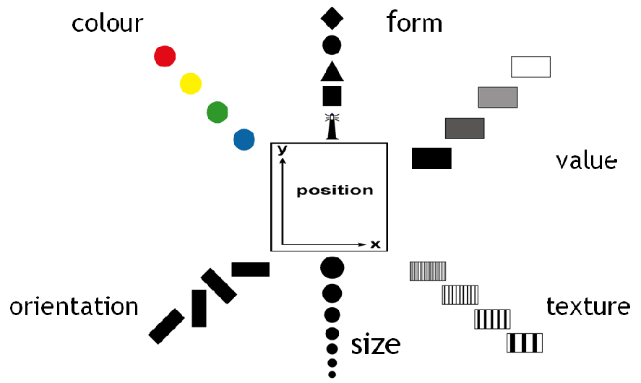
Visual variables

Slide 17
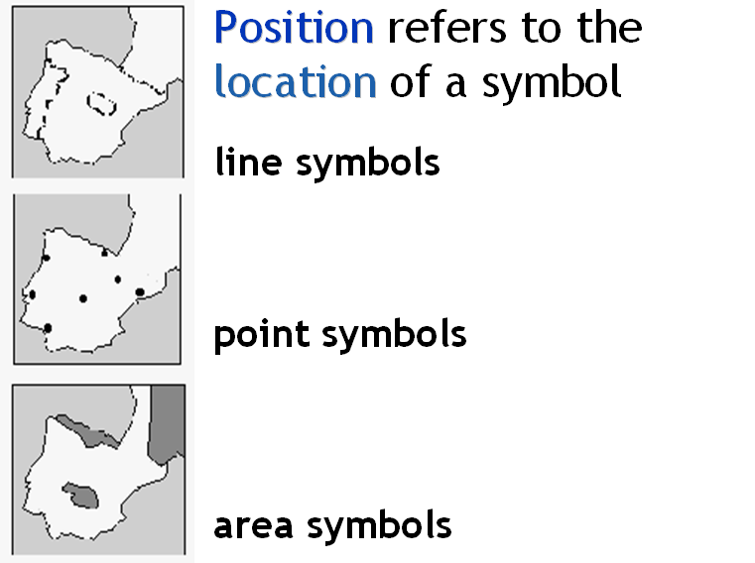
Visual variable Position

Slide 18
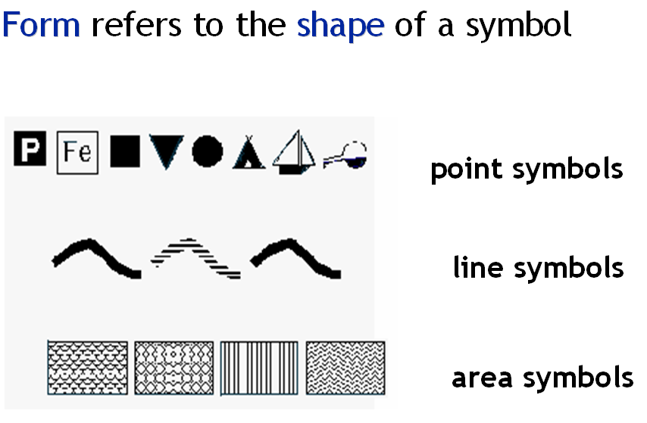
Visual variable form

Slide 19
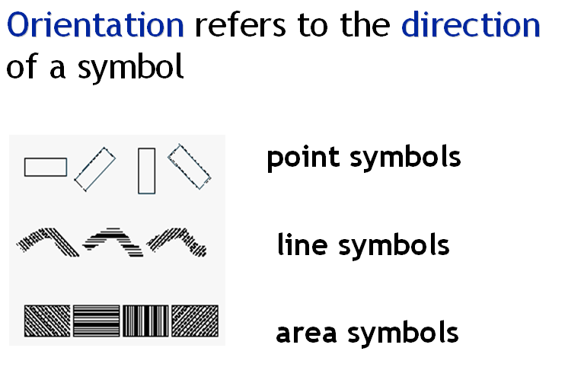
Visual variable orientation

Slide 20
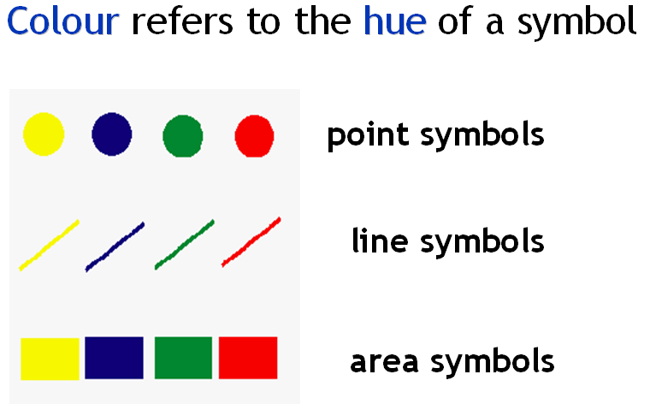
Visual variable colour

Slide 21
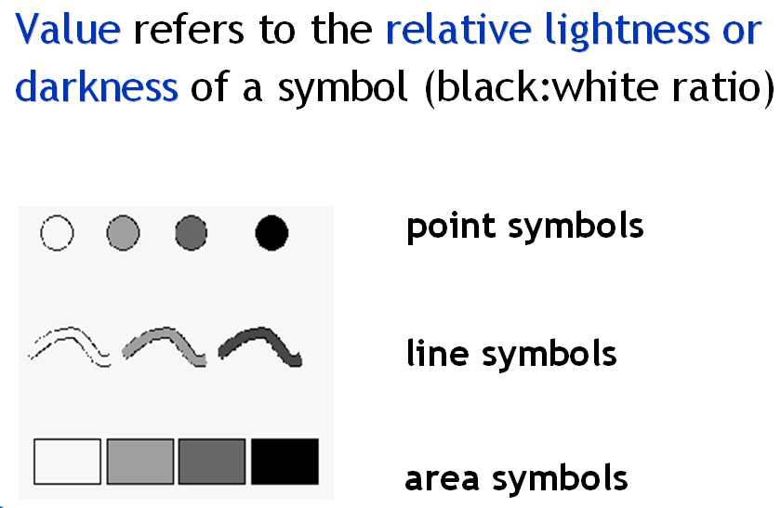
Visual variable value

Slide 22
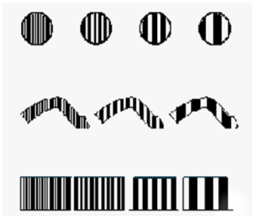
Visual variable grain/texture
Grain texture refers to the coarseness (resolution or spacing) of the graphic elements within a symbol while value remains constant.
Point symbol
Line symbol
Area symbol
Usefulness in cartography is very limited.

Slide 23
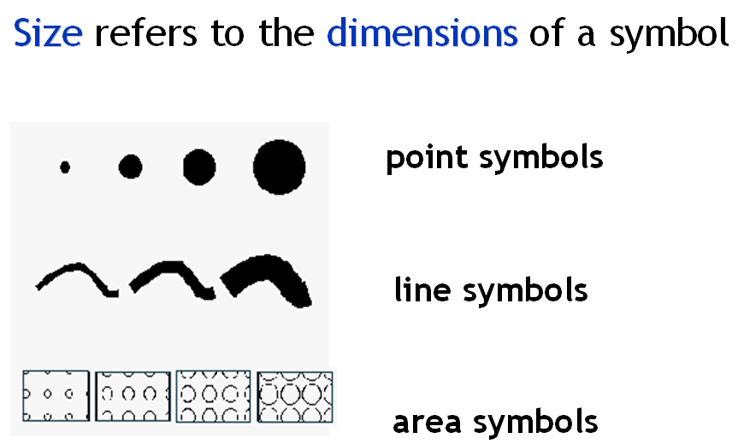
Visual variable size

Slide 24
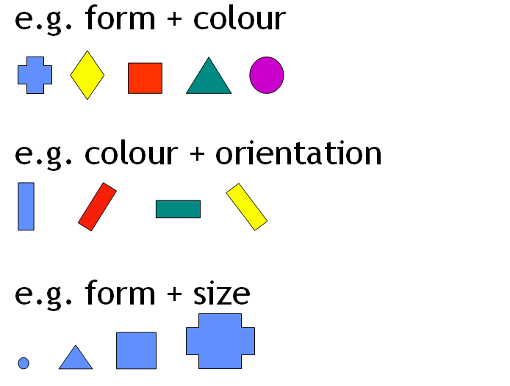
Combination of visual variables

Slide 25
Thank You

